Slide 1

Local Search and Constraints Satisfaction problem
Chapter-3

Slide 2
Local Search
Local search methods work on complete state formulations. They keep only a small number of nodes in memory.
Local search is useful for solving optimization problems:
o Often it is easy to find a solution
o But hard to find the best solution
Algorithm goal:
find optimal configuration (e.g., TSP),
Hill climbing
Gradient descent
Simulated annealing
• For some problems the state description contains all of the information relevant for a solution. Path to the solution is unimportant.
• Examples:
o map coloring
o 8-queen

Slide 3
Hill Climbing Algorithm
Very simple idea: Start from some state s,
Move to a neighbor t with better score. Repeat.
Question: what’s a neighbor?
You have to define that!
The neighborhood of a state is the set of neighbors
Also called ‘move set’
Similar to successor function

Slide 4
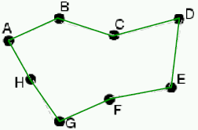
Neighbors: TSP
state: A-B-C-D-E-F-G-H-A
f = length of tour

Slide 5
Hill Climbing Algorithm
Question: What’s a neighbor?
Problems tend to have structures. A small change produces a neighboring state.
The neighborhood must be small enough for efficiency
Designing the neighborhood is critical. This is the real ingenuity – not the decision to use hill climbing.
Question: Pick which neighbor?
Question: What if no neighbor is better than the current state?

Slide 6
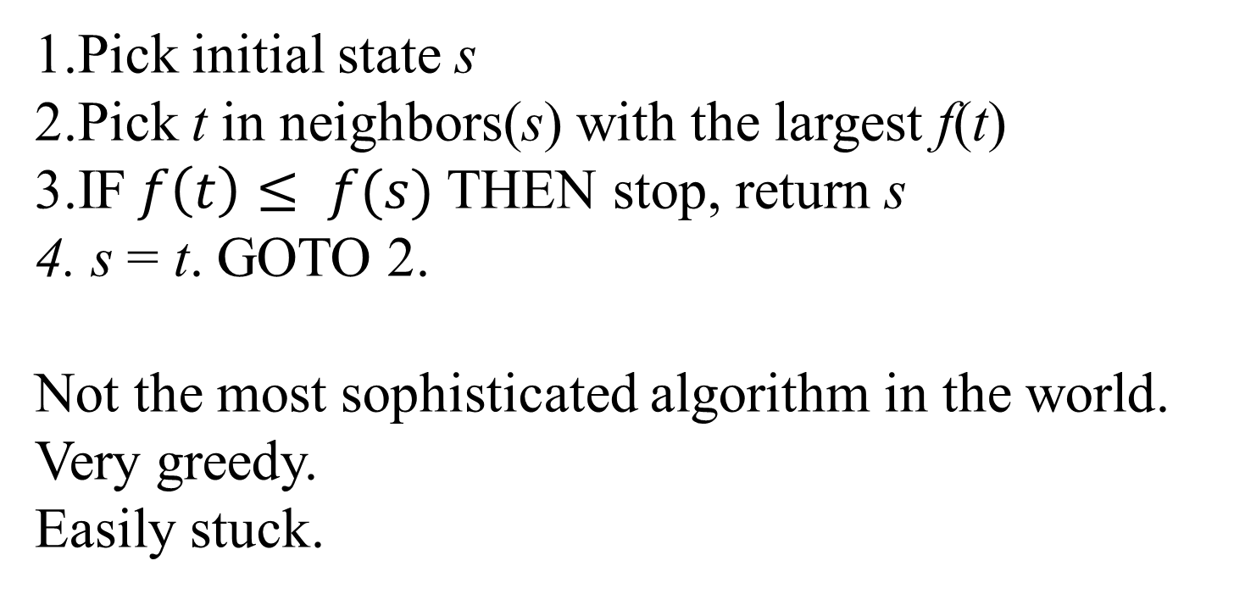
Hill Climbing Algorithm
1.Pick initial state s
2.Pick t in neighbors(s) with the largest f(t)
3.IF$f\left(t\right)≤ f(s)$THEN stop, return s
4. s = t. GOTO 2.
Not the most sophisticated algorithm in the world.
Very greedy.
Easily stuck.
your enemy:
local optima

Slide 7
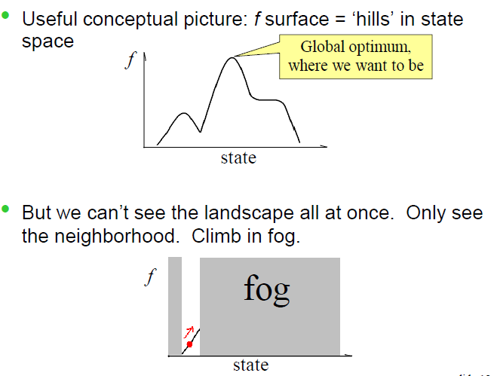
Local optima in hill climbing
The rest of the lecture is about
Escaping
local optima

Slide 8
Variation of Hill Climbing
Question: How do we make hill climbing less greedy?
▪Stochastic hill climbing
•Randomly select among better neighbors
•The better, the more likely
•Pros / cons compared with basic hill climbing?
•Question: What if the neighborhood is too large to enumerate? (e.g. N-queen if we need to pick both the column and the move within it)
▪First-choice hill climbing
•Randomly generate neighbors, one at a time
•If better, take the move
•Pros / cons compared with basic hill climbing?

Slide 9
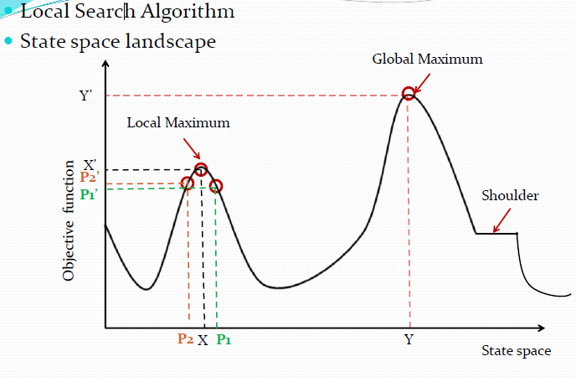
Hill Climbing Algorithm

Slide 10
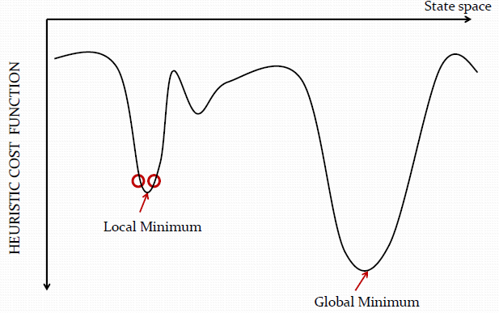
Hill Climbing Algorithm
Maximization function is called Objective Function
 Minimization function is called Heuristic Cost function
 Heuristic cost= distance, time, money spent
 Objective function= profit, success

Slide 11
Hill Climbing Algorithm
Evaluate the initial state. If it is the goal state then return and quit. Otherwise continue with initial state as current state.
Loop until a solution is found or until there are no new operators left to be applied to the current state:
a. Select operator that has not been applied to the current state and apply it to produce the new state.
b. Evaluate the new state
i. If it is the goal state, then return and quit
ii. If it is not a goal state but it is better than the current state then
make it the current state.
iii. If it is not better than the current state then continue in the loop.

Slide 12
Hill Climbing Algorithm Problems
Local maxima
Once the top of a hill is reached the algorithm will halt since every possible step leads down.
Plateaux
If the landscape is flat, meaning many states have the same goodness, algorithm degenerates to a random walk.
Ridges
If the landscape contains ridges, local improvements may follow a zigzag path up the ridge, slowing down the search.

Slide 13
Advantages of Hill Climbing
It can be used in continuous as well as discrete domains.
Disadvantages of Hill Climbing
1. Not efficient method –not suitable to problems where the value of
heuristic function drops off suddenly when solution may be in sight.
2.Local search method- gets caught up in local maxima/minima.
Solution to Local Maxima problem:
1. Simulated annealing
. Backtracking to some earlier node and try different direction.

Slide 14
SIMULATED ANNEALING
Anneal
To subject (glass or metal) to a process of heating and slow cooling in order to toughen and reduce brittleness.
1.Pick initial state s
2.Randomly pick t in neighbors(s)
3.IF f(t) better THEN accept s t.
4.ELSE /* t is worse than s */
5. accept s t with a small probability
6.GOTO 2 until bored.

Slide 15

SIMULATED ANNEALING
How to choose the small probability?
idea 1: p = 0.1
idea 2: p decreases with time
idea 3: p decreases with time, also as the ‘badness’ |f(s)-f(t)| increases
If f(t) better than f(s), always accept t
Otherwise, accept t with probability

Slide 16
SIMULATED ANNEALING
If f(t) better than f(s), always accept t
Otherwise, accept t with probability
Temp is a temperature parameter that ‘cools’ (anneals) over time, e.g. Temp Temp*0.9 which gives Temp=(T0)#iteration
High temperature: almost always accept any t
Low temperature: first-choice hill climbing
If the ‘badness’ (formally known as energy difference) |f(s)-f(t)| is large, the probability is small.

Slide 17
SA Algorithm
assuming we want to maximize f()
current = Initial-State(problem)
for t = 1 to œ do
T = Schedule(t) ; // T is the current temperature, which is monotonically decreasing with t
if T=0 then return current ; //halt when temperature = 0
next = Select-Random-Successor-State(current) deltaE = f(next) - f(current) ; // If positive, next is better than current. Otherwise, next is worse than current.
if deltaE > 0 then current = next ; // always move to a better state
else current = next with probability p = exp(deltaE / T) ; // as T 0,
p 0; as deltaE → -, p →0
end

Slide 18
SA Algorithm Design Issues
Cooling scheme important
Neighborhood design is the real ingenuity, not the decision to use simulated annealing.
Not much to say theoretically
▪With infinitely slow cooling rate, finds global optimum with probability 1.
Proposed by Metropolis in 1953 based on the analogy that alloys manage to find a near global minimum energy state, when annealed slowly.
Easy to implement.
Try hill-climbing with random restarts first!

Slide 19
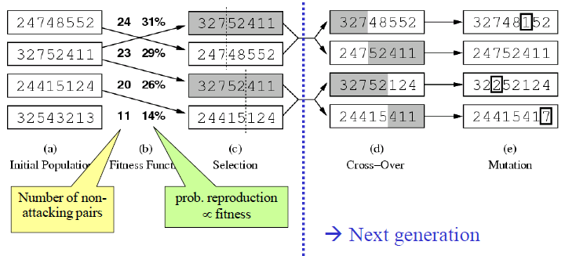
Genetic algorithm
Genetic algorithm: a special way to generate neighbors, using the analogy of cross-over, situutation, and natural selection.

Slide 20
Genetic Algorithms
In the early 1970s, John Holland introduced the
concept of genetic algorithms.
His aim was to make computers do what nature
does. Holland was concerned with algorithms
that manipulate strings of binary digits.
Each artificial “chromosomes” consists of a
number of “genes”, and each gene is represented
by 0 or 1:

Slide 21
Genetic Algorithms
Nature has an ability to adapt and learn without
being told what to do. In other words, nature
finds good chromosomes blindly. GAs do the
same. Two mechanisms link a GA to the problem
it is solving: encoding and evaluation.
The GA uses a measure of fitness of individual
chromosomes to carry out reproduction. As
reproduction takes place, the crossover operator
exchanges parts of two single chromosomes, and
the mutation operator changes the gene value in
some randomly chosen location of the chromosome.

Slide 22
Basic Genetic Algorithms
Step 1: Represent the problem variable domain as
a chromosome of a fixed length, choose the size
of a chromosome population N, the crossover
probability pc and the mutation probability pm.
Step 2: Define a fitness function to measure the
performance, or fitness, of an individual
chromosome in the problem domain. The fitness
function establishes the basis for selecting
chromosomes that will be mated during
reproduction.

Slide 23
Basic Genetic Algorithms
Step 3: Randomly generate an initial population of
chromosomes of size N:
x1, x2, . . . , xN
Step 4: Calculate the fitness of each individual
chromosome:
f (x1), f (x2), . . . , f (xN)
Step 5: Select a pair of chromosomes for mating
from the current population. Parent
chromosomes are selected with a probability
related to their fitness.

Slide 24
Basic Genetic Algorithms
Step 6: Create a pair of offspring chromosomes by
applying the genetic operators − crossover and
mutation.
Step 7: Place the created offspring chromosomes
in the new population.
Step 8: Repeat Step 5 until the size of the new
chromosome population becomes equal to the
size of the initial population, N.
Step 9: Replace the initial (parent) chromosome
population with the new (offspring) population.
Step 10: Go to Step 4, and repeat the process until
the termination criterion is satisfied.

Slide 25
Genetic Algorithms
GA represents an iterative process. Each iteration is
called a generation. A typical number of generations
for a simple GA can range from 50 to over 500. The
entire set of generations is called a run.
Because GAs use a stochastic search method, the
fitness of a population may remain stable for a
number of generations before a superior chromosome
appears.
A common practice is to terminate a GA after a
specified number of generations and then examine
the best chromosomes in the population. If no
satisfactory solution is found, the GA is restarted.

Slide 26
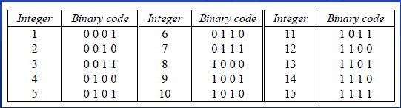
Genetic algorithms: case study
A simple example will help us to understand how
a GA works. Let us find the maximum value of
the function (15x − x2) where parameter x varies
between 0 and 15. For simplicity, we may
assume that x takes only integer values. Thus,
chromosomes can be built with only four genes:

Slide 27
Genetic algorithms: case study
Suppose that the size of the chromosome population
N is 6, the crossover probability pc equals 0.7, and
the mutation probability pm equals 0.001. The
fitness function in our example is defined by
f(x) = 15 x − x2

Slide 28
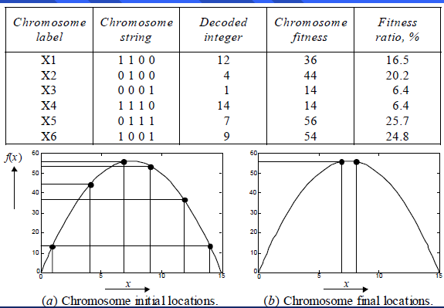
The fitness function and chromosome locations

Slide 29
In natural selection, only the fittest species can
survive, breed, and thereby pass their genes on to
the next generation. GAs use a similar approach,
but unlike nature, the size of the chromosome
population remains unchanged from one
generation to the next.
The last column in Table shows the ratio of the
individual chromosome’s fitness to the
population’s total fitness. This ratio determines
the chromosome’s chance of being selected for
mating. The chromosome’s average fitness
improves from one generation to the next.

Slide 30
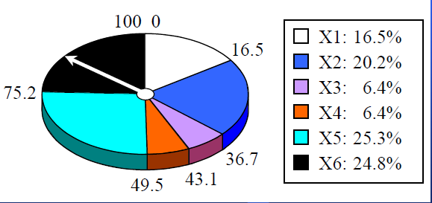
Roulette wheel selection
The most commonly used chromosome selection techniques is the roulette wheel selection.

Slide 31
Crossover operator
In our example, we have an initial population of 6
chromosomes. Thus, to establish the same
population in the next generation, the roulette
wheel would be spun six times.
Once a pair of parent chromosomes is selected,
the crossover operator is applied.
First, the crossover operator randomly chooses a
crossover point where two parent chromosomes
“break”, and then exchanges the chromosome
parts after that point. As a result, two new
offspring are created.
If a pair of chromosomes does not cross over,
then the chromosome cloning takes place, and the
offspring are created as exact copies of each
parent.

Slide 32
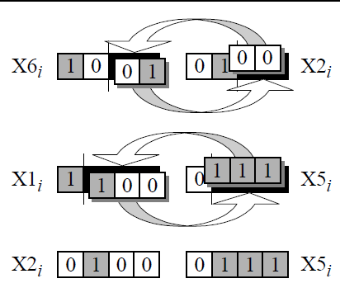
Crossover operator

Slide 33
Mutation operator
Mutation represents a change in the gene.
Mutation is a background operator. Its role is to
provide a guarantee that the search algorithm is
not trapped on a local optimum.
The mutation operator flips a randomly selected
gene in a chromosome.
The mutation probability is quite small in nature,
and is kept low for GAs, typically in the range
between 0.001 and 0.01.

Slide 34
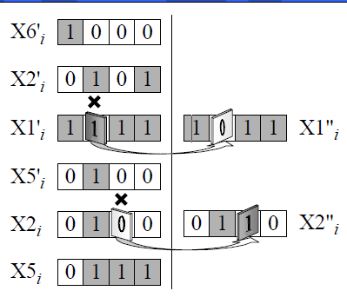
Mutation operator

Slide 35
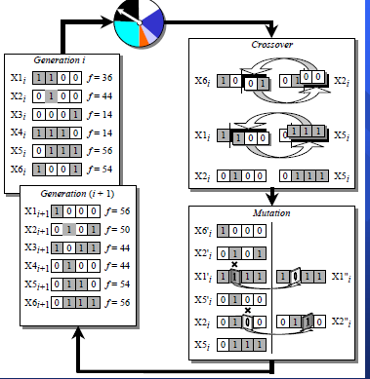
The genetic algorithm cycle

Slide 36
Steps in the GA development
1. Specify the problem, define constraints and
optimum criteria;
2. Represent the problem domain as a
chromosome;
3. Define a fitness function to evaluate the
chromosome performance;
4. Construct the genetic operators;
5. Run the GA and tune its parameters.

Slide 37
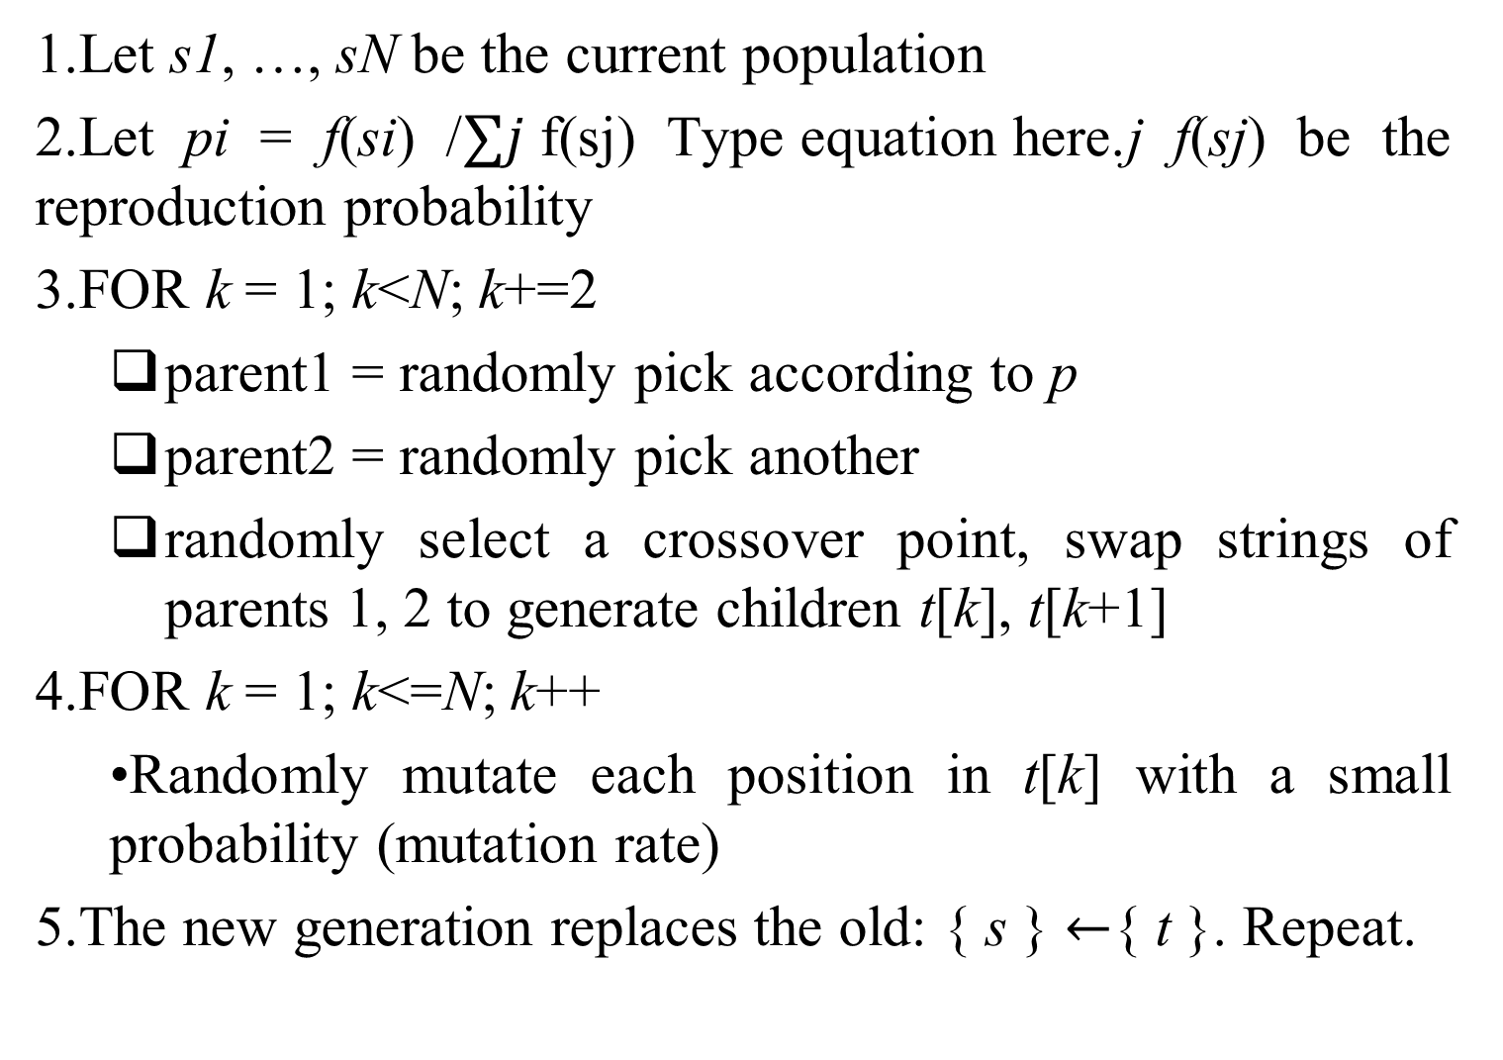
Genetic algorithm
1.Let s1, …, sN be the current population
2.Let pi = f(si) /$∑j$f(sj) j f(sj) be the reproduction probability
3.FOR k = 1; k<N; k+=2
parent1 = randomly pick according to p
parent2 = randomly pick another
randomly select a crossover point, swap strings of parents 1, 2 to generate children t[k], t[k+1]
4.FOR k = 1; k<=N; k++
•Randomly mutate each position in t[k] with a small probability (mutation rate)
5.The new generation replaces the old: { s } $←${ t }. Repeat.

Slide 38
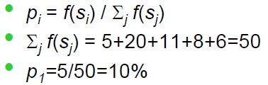
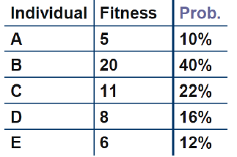
Proportional selection

Slide 39
Variations of genetic algorithm
Parents may survive into the next generation
Use ranking instead of f(s) in computing the reproduction probabilities.
Cross over random bits instead of chunks.
Optimize over sentences from a programming language.

Slide 40
Constraint Satisfaction Problems
Constraint satisfaction problems or CSPs are mathematical problems where one must find states or objects that satisfy a number of constraints or criteria. A constraint is a restriction of the feasible solutions in an optimization problem
Many problems can be stated as constraints satisfaction problems. Here are some examples
Example 1: The n-Queen problem is the problem of putting n chess queens on an n×n chessboard such that none of them is able to capture any other using the standard chess queen's moves. The color of the queens is meaningless in this puzzle, and any queen is assumed to be able to attack any other. Thus, a solution requires that no two queens share the same row, column, or diagonal.
The problem was originally proposed in 1848 by the chess player Max Bazzel, and over the years, many mathematicians, including Gauss have worked on this puzzle. In 1874, S. Gunther proposed a method of finding solutions by using determinants, and J.W.L. Glaisher refined this approach

Slide 41

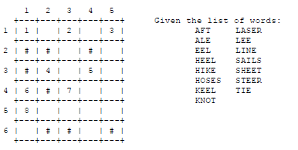
The eight queens puzzle has 92 distinct solutions. If solutions that differ only by symmetry operations (rotations and reflections) of the board are counted as one, the puzzle has 12 unique solutions. The following table gives the number of solutions for n queens, both unique and distinct.
Note that the 6 queens puzzle has, interestingly, fewer solutions than the 5 queens puzzle!
Example 2: A crossword puzzle: We are to complete the puzzle

Slide 42
We’ve seen CSP before!
Constraint satisfaction problem (CSP) is a special
class of search problem
Each problem has a set of variables (e.g. A,B,C,D,E)
• Each variable take a value from a domain (e.g. {T,F})
• Each problem has a set of constraints (e.g A  ➢B  C=T)
• Objective: find a complete assignment of variables that
satisfies all the constraints.
• What are v/v/d/c of 8-queen? Map coloring?

Slide 43
CSP definition
CSP is a triplet {V, D, C}
• V = {V1, V2, …, Vn} a finite set of variables
• Each variable may be assigned a value from domain Di
• Each member of C is a pair
▪ First member: a subset of variables
▪ Second member: a set of valid values
• Example:
V = {V1, V2, …, V7}
D = {R, G, B}
C = { (V1, V2):{(R,G), (R,B), (G,B), (G,R), (B,G), (B,R)},
(V1, V3):{(R,G), (R,B), (G,B), (G,R), (B,G), (B,R)},
…
} (obvious point: C is often represented as a function)
• How did we solve this?

Slide 44
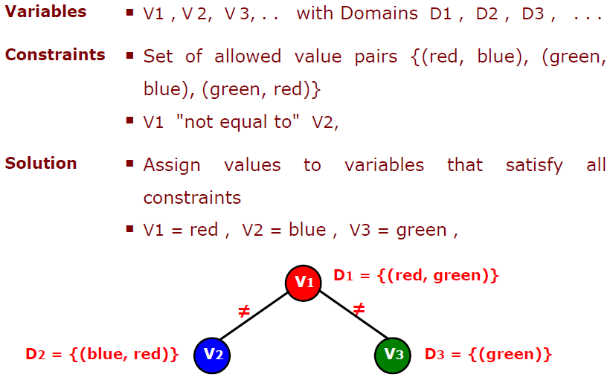
CSP Examle

Slide 45
Old solution #2: BFS, DFS, …
• State: partial assignment. (V1…Vk-1 assigned, Vk…Vn
not yet).
• Start state: all variables unassigned
• Goal state: all assigned, constraints satisfied
• Successor of (V1…Vk-1 assigned, Vk…Vn not yet):
assign Vk with a value from Dk
• Cost on transitions: 0 is fine. We don’t care. We just
want any solution

Slide 46
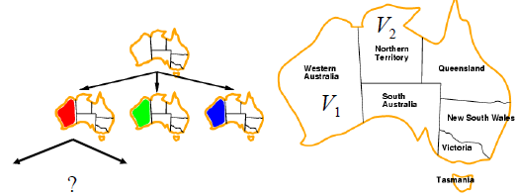
Map coloring example
• State: partial assignment. (V1…Vk-1 assigned, Vk…Vn
not yet).
• Start state: all variables unassigned
• Goal state: all assigned, constraints satisfied
• Successor of (V1…Vk-1 assigned, Vk…Vn not yet):
assign Vk with a value from Dk
• Cost on transitions: 0 is fine. We don’t care. We just
want any solution
It turns out BFS is bad. Why?

Slide 47
Representation of CSP
A CSP is usually represented as an undirected graph, called Constraint Graph where the nodes are the variables and the edges are the binary constraints. Unary constraints can be disposed of by just redefining the domains to contain only the values that satisfy all the unary constraints. Higher order constraints are represented by hyperarcs.

Slide 48
Solving CSPs
There have four popular solution methods for CSPs amely, Generate-and-Test, Backtracking, Consistency Driven, and Forward Checking.
Generate and Test
We generate one by one all possible complete variable assignments and for each we test if it satisfies all constraints. The corresponding program structure is very simple, just nested loops, one per variable. In the innermost loop we test each constraint. In most situation this method is intolerably slow.
Backtracking
We order the variables in some fashion, trying to place first the variables that are more highly constrained or with smaller ranges. This order has a great impact on the efficiency of solution algorithms and is examined elsewhere. We start assigning values to variables. We check constraint satisfaction at the earliest possible time and extend an assignment if the constraints involving the currently bound variables are satisfied.

Slide 49
Solving CSPs
Consistency Driven Techniques
Consistency techniques effectively rule out many inconsistent labeling at a very early stage, and thus cut short the search for consistent labeling. These techniques have since proved to be effective on a wide variety of hard search problems. The consistency techniques are deterministic, as opposed to the search which is non-deterministic. Thus the deterministic computation is performed as soon as possible and non-deterministic computation during search is used only when there is no more propagation to done. Nevertheless, the consistency techniques are rarely used alone to solve constraint satisfaction problem completely (but they could).
In binary CSPs, various consistency techniques for constraint graphs were introduced to prune the search space. The consistency-enforcing algorithm makes any partial solution of a small subnetwork extensible to some surrounding network. Thus, the potential inconsistency is detected as soon as possible.
Node Consistency, Arc Consistency , Path Consistency (K-Consistency)
Forward Checking
Forward checking is the easiest way to prevent future conflicts. Instead of performing arc consistency to the instantiated variables, it performs restricted form of arc consistency to the not yet instantiated variables. We speak about restricted arc consistency because forward checking checks only the constraints between the current variable and the future variables. When a value is assigned to the current variable, any value in the domain of a "future" variable which conflicts with this assignment is (temporarily) removed from the domain. The advantage of this is that if the domain of a future variable becomes empty, it is known immediately that the current partial solution is inconsistent. Forward checking therefore allows branches of the search tree that will lead to failure to be pruned earlier than with simple backtracking. Note that whenever a new variable is considered, all its remaining values are guaranteed to be consistent with the past variables, so the checking an assignment against the past assignments is no longer necessary.

Slide 50
Confession
It is possible that some sentences or some information were included in these slides without mentioning exact references. I am sorry for violating rules of intellectual property. When I will have a bit more time, I will try my best to avoid such things.
These slides are only for students in order to give them very basic concepts about the giant, “Networking”, not for experts.
Since I am not a network expert, these slides could have wrong/inconsistent information…I am sorry for that.
Students are requested to check references and Books, or to talk to Network engineers.

